Slide 1
Decision Trees for Classification
Julia Ive
Queen Mary University of London
based on material by Joshua Reiss, Simon Dixon, Boris Mailhé and Alan Neymark
School of Electronic Engineering and Computer Science
Queen Mary University of London

Slide 2
Outline
Classification problem
Geometrical Interpretation
Attribute selection
ID3 algorithm
Avoiding overfitting

Slide 3
Learning Outcomes
Being familiar with the classification problem in AI
Being able to explain the following concepts:
Decision tree
Entropy and information gain as used in decision trees
Overfitting
Being able to define training, validation and test sets and their relationship to overfitting
Being able to build ID3 manually on paper for symbolic and numerical attributes

Slide 4
Outline
Classification problem
Geometrical Interpretation
Attribute selection
ID3 algorithm
Avoiding overfitting

Slide 5
Definition
Classification problem
Given examples described by several attributes (or features) & set of classes, label each example with a class

Slide 6
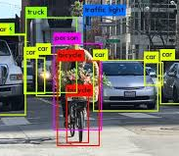
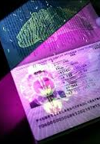
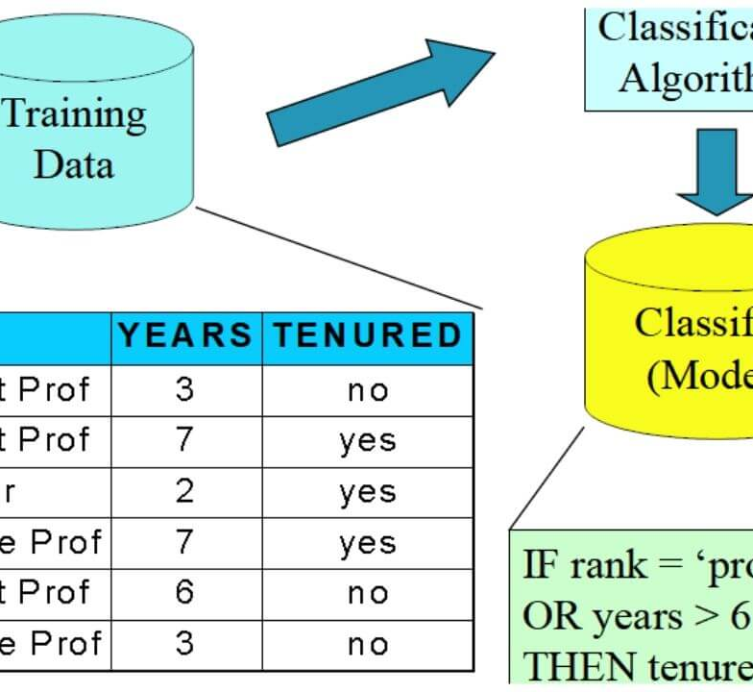
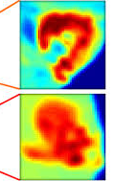
Classification Applications
Biometry: identify people from their voice, face, gait, ...
Data mining: predict user behaviour depending on their past history
Category recognition: e.g. objects in images; speech; document topic; musical instrument, style, mood
Medical diagnosis: knowing symptoms and eventual test results, determine whether patient has a particular disease

Slide 7
Machine learning for classification
Classifier: takes features describing object, returns object’s class
Machine learning approach
Learn classifier from the training set:
Set of items which are described by attributes and their values, including the attribute for which the classifier is being trained (predicted label)
Supervised learning: classes of training examples are known
Training set is much smaller than the problem set
Learning step may be costly but is performed only once
Then the classifier can be applied to problem examples

Slide 8
Outline
Classification problem
Geometrical Interpretation
Attribute selection
ID3 algorithm
Avoiding overfitting

Slide 9
Classification: geometrical view
Examples lie in the attribute space
Each attribute is a dimension
Each example is a point
In these slides, classes are represented by colours
A classifier embodies a partition of the attribute space
The whole space is divided into non-overlapping pieces (subspaces)
Learning a classifier is partitioning training set into homogeneous subsets
Each subspace contains training examples of exactly one class
Applying classifier is just checking in which subspace a point lies

Slide 10
Classification: geometrical view
?
Problem
Attributes are dimensions (axes)
Examples are points
Classifier
Colour the whole space

Slide 11
Learning a classifier
Select training examples
Draw the borders
Colour the subspaces

Slide 12
Applying the classifier
Locate the points
Colour the points

Slide 13

Structure of the classifier
Subspaces of classifier do not have to be connected
Border can be much more complex than single line
Generally, types of borders allowed are set by algorithm
Need expert knowledge of problem
No single algorithm solves every problem

Slide 14
Outline
Classification problem
Geometrical Interpretation
Attribute selection
ID3 algorithm
Avoiding overfitting

Slide 15
Attribute Types
Symbolic attributes
Finite, discrete valued: e.g. gender, marital status,...
No notion of order or distance between values, only Boolean comparison
Can be enumerated
Use logic to combine different attributes after testing them
Numeric attributes
Real or integer valued: e.g. grades, temperature, pixels, audio samples, ...
Can be measured
Can use algebra to combine different attributes before testing them
Can create new attributes

Slide 16
Attribute selection/engineering
Learning is hard
Learning algorithms usually costly & suboptimal
Learning is easier if one starts with “good” attributes
Fewer attributes decrease cost of learning
Good initial guess helps finding the best classifier
What is a good attribute?
An attribute that carries a lot of “information”
An attribute whose “information” is related to the class

Slide 17
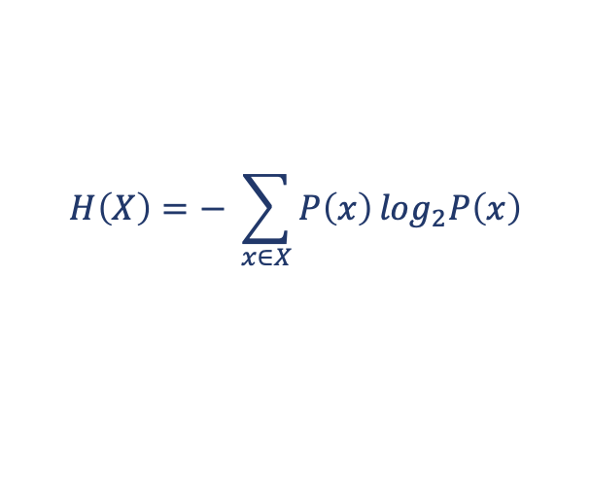
Entropy
Entropy - lower bound on the average number of bits required to represent or transmit an event drawn from the probability distribution for the random variable X
Probability of the event x
Random variable
$$H\left(X\right)=− \sum_{x∈X}^{ }{P\left(x\right)⁡\log_{2}P\left(x\right)}$$
Does log base 2 matter? Can we use natural logarithm or base 10?
Number of bits to encode the event x
For each event x in all possible events X

Slide 18
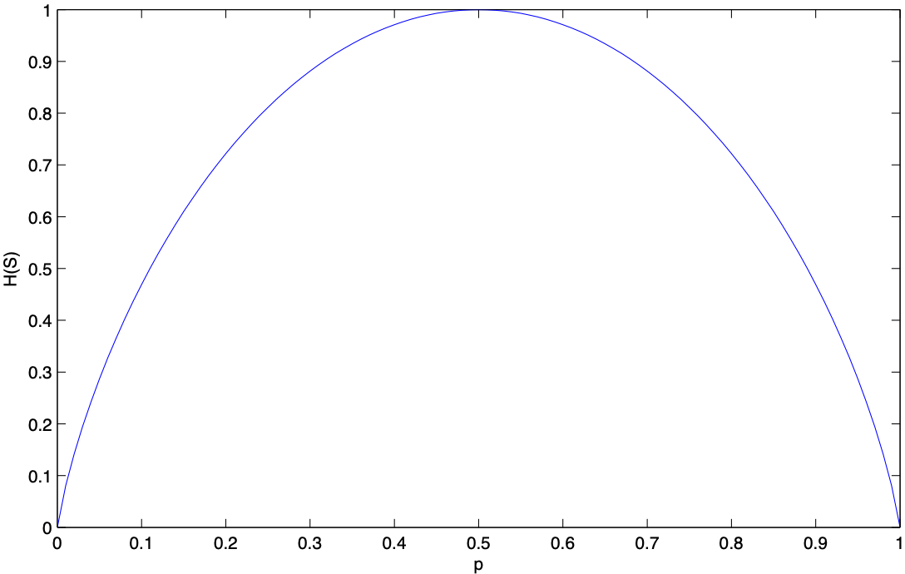
Example: coin toss
Two possible values (X = {Heads, Tails})
respective frequencies p_{Heads} = p and p_{Tails} = 1 - p
$$H\left(X\right)=−p\log_{2}{p −\left(1−p\right)\log_{2}(1−p)}$$

Slide 19
Mutual information
Objective: measure how much of the information in two random variables is shared
0 if the variables are independent
Maximal if one variable is a function of the other
Mutual information:
I(X;Y) = H(X) + H(Y) - H(X,Y)
H(X)
H(Y)
I(X;Y)
H(X,Y)

Slide 20
Back to attribute selection
Finding attributes with high entropy
Finding features with high mutual information with the classes:
Expert knowledge may be available
Common sense and domain knowledge works
E.g., do not classify text documents based on frequency of “a”, “the”, “and” ...

Slide 21
Outline
Classification problem
Geometrical Interpretation
Attribute selection
ID3 algorithm
Avoiding overfitting

Slide 22
Decision trees
Tool to represent decision making
Decompose complex problem into sequence of simple questions
Which question to ask next depends on previous answers
Represented as a tree
Tree structure:
Leaves: decisions
Nodes: questions
Branches: possible answers to the parent question

Slide 23
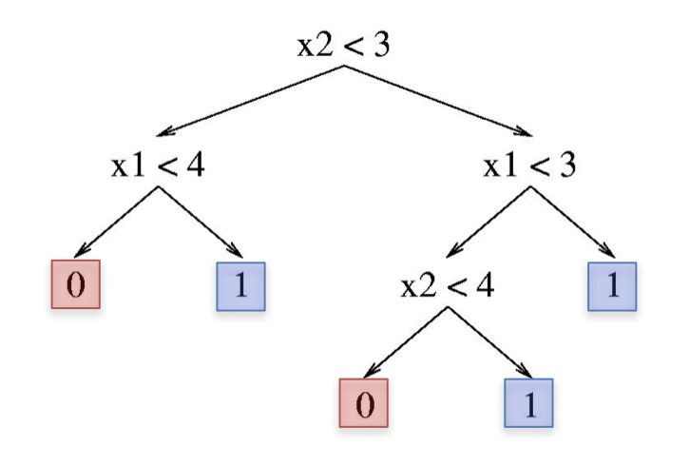
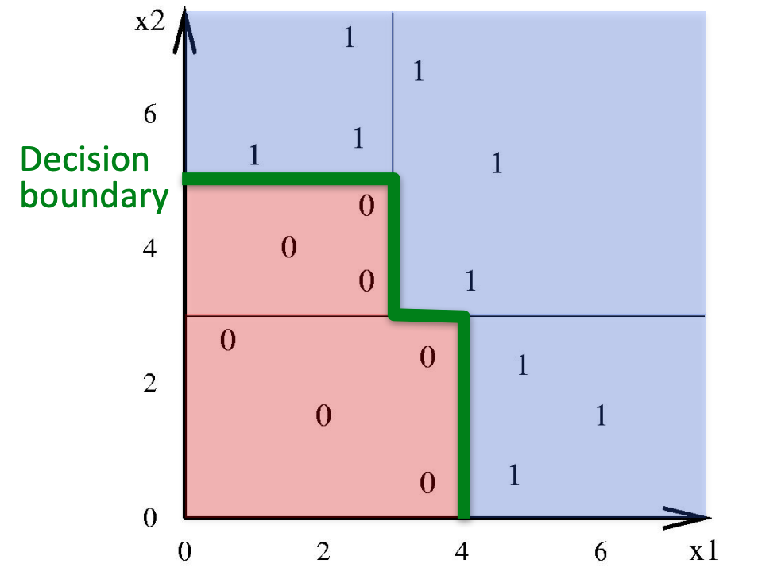
Decision trees and classification
Classification is a decision problem: which label applies to data point?
Classifiers represented as decision tree
Decision tree also partitions attribute space
Question: on which side of given border is point we are interested in?
Several trees can represent same classifier
https://www.cc.gatech.edu/~bboots3/CS4641-Fall2018/Lecture2/02_DecisionTrees.pdf

Slide 24
Decision trees and classification
Learning problem: which questions to ask?
If one asks enough questions, one will eventually classify training set
1 question = 1 new split of the space
With enough splits, one can eventually separate each training point from all others
But would that classifier generalise to new data?
Classifier should be general
Classifier should be fast to apply after learning
Build classifier that needs to ask few questions before taking decision (shallow, bushy tree)

Slide 25
Greedy Algorithm
Goal: reach largest sum
Greedy algorithm will take what appears to be optimal choice at each step
No backtracking
So it will choose 12 instead of 3 at second step
Will not reach best solution, which contains 99
We will look at one Greedy Algorithm - ID3 (Iterative Dichotomiser 3)

Slide 26
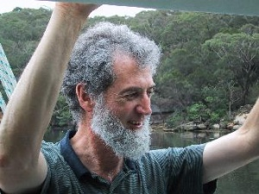
ID3 algorithm (Quinlan 1986)
ID3 takes training set & builds decision tree so that each leaf is homogeneous (represents single class label)
Builds tree from root to leaves
ID3(Training_Set) =
if all points in Training_Set have same class C
return Leaf(C);
elseif no questions remain for Training_Set
return Leaf(MajorityClass(Training_Set));
else
Question = Find_Best_Question(Training_Set);
[Set_1,...,Set_n] = Split(Training_set, Question);
return Tree(Question, ID3(Set_1),...,ID3(Set_n));
Ross Quinlan
How does Find_Best_Question work?
Which questions are allowed?
How to select the best one?

Slide 27
Finding the next question to ask
ID3 restricts itself to questions that test only one attribute
Less questions to choose from
Works well for symbolic attributes
Symbolic attributes can be enumerated
Symbolic attributes cannot be combined
Entropy of a set of items measures the average amount of information (in bits) required to encode the class label for an arbitrary example from the dataset
Information gain measures the change in entropy as the result of partitioning the set according to an attribute
Attributes are chosen so that resulting subsets are as well-classified as possible

Slide 28
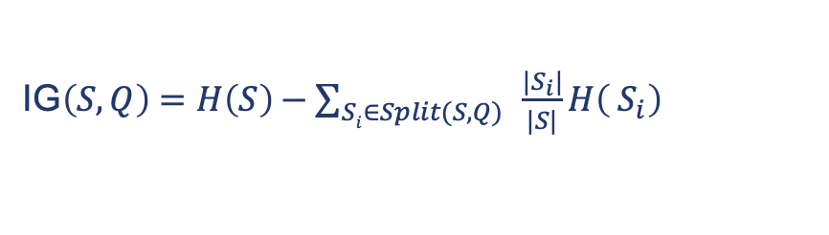
Finding the best question
Entropy of partition is sum of entropies of subsets weighted by the ratio of the number of examples belonging to each subset
Information gain is defined as difference between total entropies before and after partitioning set S into subsets S_{i}:
Its also mutual information between attribute & class, conditioned to previous splits
Compute IG for all possible questions Q and select Q with largest IG(S,Q)
Entropy also provides stopping criterion: leaf is node with entropy 0
IG$\left(S, Q\right)=H\left(S\right)−\sum_{Si∈Split(S, Q)}^{ }{{\frac{{|S}_{i}|}{|S|}}H\left( S_{i}\right)}$

Slide 29
Which questions to ask?
Symbolic attributes (gender, hair colour,...)
Only finite number of possible values for all data
Numerical attributes (temperature, pixel value,...)
Infinite range even if only finite number of values present in training set
So choose threshold t and ask: is value < t ?
Threshold choice
Information gain criterion still holds
Best threshold must be between two training examples of different classes
Try all such candidates, using midpoint between opposite training examples
t1
t3
t2

Slide 30

Example: Will the lecture be well-attended?
Outlook | Temperature | Windy | Well-attended
sunny | 29 | No | Yes
sunny | 27 | Yes | No
overcast | 28 | No | Yes
rain | 21 | Yes | No
rain | 20 | No | Yes
rain | 18 | Yes | No
overcast | 17 | Yes | Yes
sunny | 22 | No | No
Training data
H(S)=-$\left(\frac{4}{8}\log_{2}\frac{4}{8}\right)$- $\left(\frac{4}{8}\log_{2}\frac{4}{8}\right)$ = 1

Slide 31



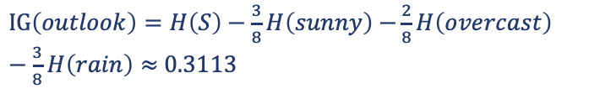

Example: split along Outlook
Outlook | Temperature | Windy | Well-attended
sunny | 29 | No | Yes
sunny | 27 | Yes | No
overcast | 28 | No | Yes
rain | 21 | Yes | No
rain | 20 | No | Yes
rain | 18 | Yes | No
overcast | 17 | Yes | Yes
sunny | 22 | No | No
H(S)=-$\left(\frac{4}{8}\log_{2}\frac{4}{8}\right)$- $\left(\frac{4}{8}\log_{2}\frac{4}{8}\right)$ = 1
$H\left(sunny\right)$=-$\left(\frac{1}{3}\log_{2}\frac{1}{3}\right)$- $\left(\frac{2}{3}\log_{2}\frac{2}{3}\right)$ $≈0.9183$
$H\left(overcast\right)$=-$\left(\frac{2}{2}\log_{2}\frac{2}{2}\right)$- $\left(\frac{0}{2}\log_{2}\frac{0}{2}\right)$ $≈0$
$H\left(rain\right)$=-$\left(\frac{1}{3}\log_{2}\frac{1}{3}\right)$- $\left(\frac{2}{3}\log_{2}\frac{2}{3}\right)$ $≈0.9183$
$IG\left(outlook\right)=H\left(S\right)−\frac{3}{8}H\left(sunny\right)$ $−\frac{2}{8}H\left(overcast\right)$ $−\frac{3}{8}H\left(rain\right)≈$ 0.3113

Slide 32
Example: split along Temperature
Outlook | Temperature | Windy | Well-attended
sunny | 29 | No | Yes
sunny | 27 | Yes | No
overcast | 28 | No | Yes
rain | 21 | Yes | No
rain | 20 | No | Yes
rain | 18 | Yes | No
overcast | 17 | Yes | Yes
sunny | 22 | No | No
17.5
20.5
27.5
19

Slide 33

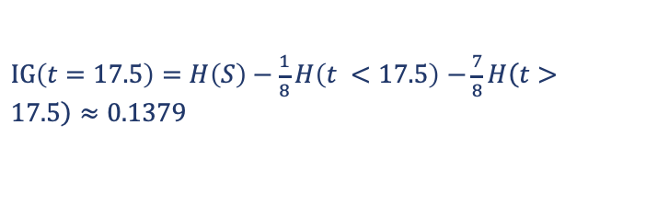


Example: split at t=17.5°C
Outlook | Temperature | Windy | Well-attended
sunny | 29 | No | Yes
sunny | 27 | Yes | No
overcast | 28 | No | Yes
rain | 21 | Yes | No
rain | 20 | No | Yes
rain | 18 | Yes | No
overcast | 17 | Yes | Yes
sunny | 22 | No | No
H(S)=-$\left(\frac{4}{8}\log_{2}\frac{4}{8}\right)$- $\left(\frac{4}{8}\log_{2}\frac{4}{8}\right)$ = 1
$H\left(t<17.5\right)$=-$\left(\frac{1}{1}\log_{2}\frac{1}{1}\right)$- $\left(\frac{0}{1}\log_{2}\frac{0}{1}\right)$ $≈0$
$H\left(t>17.5\right)$=-$\left(\frac{3}{7}\log_{2}\frac{3}{7}\right)$- $\left(\frac{4}{7}\log_{2}\frac{4}{7}\right)$ $≈0.9852$
$IG\left(t=17.5\right)=H\left(S\right)−\frac{1}{8}H\left(t <17.5\right)$ $−\frac{7}{8}H\left(t>17.5\right)≈$ 0.1379

Slide 34
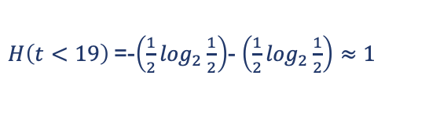
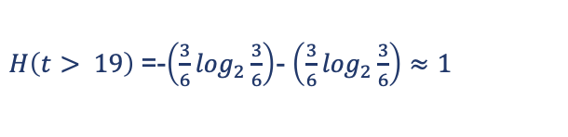
Example: split at t=19°C
Outlook | Temperature | Windy | Well-attended
sunny | 29 | No | Yes
sunny | 27 | Yes | No
overcast | 28 | No | Yes
rain | 21 | Yes | No
rain | 20 | No | Yes
rain | 18 | Yes | No
overcast | 17 | Yes | Yes
sunny | 22 | No | No
$H\left(t<19\right)$=-$\left(\frac{1}{2}\log_{2}\frac{1}{2}\right)$- $\left(\frac{1}{2}\log_{2}\frac{1}{2}\right)$ $≈1$
$H\left(t> 19\right)$=-$\left(\frac{3}{6}\log_{2}\frac{3}{6}\right)$- $\left(\frac{3}{6}\log_{2}\frac{3}{6}\right)$ $≈1$
$IG\left(t=19\right)=H\left(S\right)−\frac{2}{8}H\left(t<19\right)$ $−\frac{6}{8}H\left(t>19\right)=0$

Slide 35
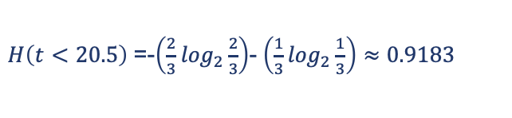
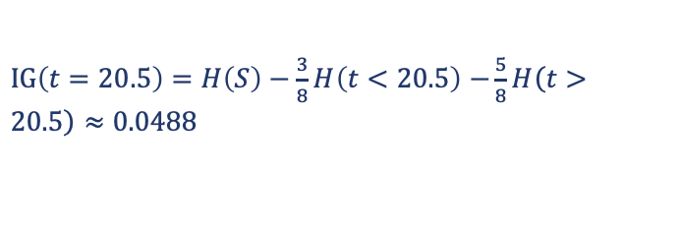
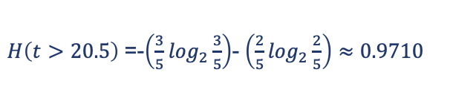
Example: split at t=20.5°C
Outlook | Temperature | Windy | Well-attended
sunny | 29 | No | Yes
sunny | 27 | Yes | No
overcast | 28 | No | Yes
rain | 21 | Yes | No
rain | 20 | No | Yes
rain | 18 | Yes | No
overcast | 17 | Yes | Yes
sunny | 22 | No | No
$H\left(t<20.5\right)$=-$\left(\frac{2}{3}\log_{2}\frac{2}{3}\right)$- $\left(\frac{1}{3}\log_{2}\frac{1}{3}\right)$ $≈0.9183$
$H\left(t>20.5\right)$=-$\left(\frac{3}{5}\log_{2}\frac{3}{5}\right)$- $\left(\frac{2}{5}\log_{2}\frac{2}{5}\right)$ $≈0.9710$
$IG\left(t=20.5\right)=H\left(S\right)−\frac{3}{8}H\left(t<20.5\right)$ $−\frac{5}{8}H\left(t>20.5\right)≈0.0488$

Slide 36
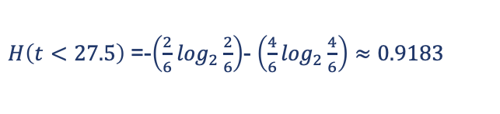
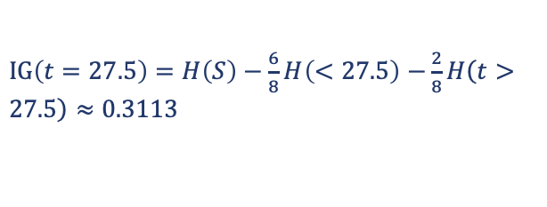
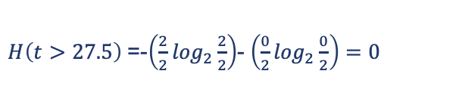
Example: split at t=27.5°C
Outlook | Temperature | Windy | Well-attended
sunny | 29 | No | Yes
sunny | 27 | Yes | No
overcast | 28 | No | Yes
rain | 21 | Yes | No
rain | 20 | No | Yes
rain | 18 | Yes | No
overcast | 17 | Yes | Yes
sunny | 22 | No | No
$H\left(t<27.5\right)$=-$\left(\frac{2}{6}\log_{2}\frac{2}{6}\right)$- $\left(\frac{4}{6}\log_{2}\frac{4}{6}\right)$ $≈0.9183$
$H\left(t>27.5\right)$=-$\left(\frac{2}{2}\log_{2}\frac{2}{2}\right)$- $\left(\frac{0}{2}\log_{2}\frac{0}{2}\right)$ $=0$
$IG\left(t=27.5\right)=H\left(S\right)−\frac{6}{8}H\left(<27.5\right)$ $−\frac{2}{8}H\left(t>27.5\right)≈0.3113$

Slide 37


Example: split along windy
Outlook | Temperature | Windy | Well-attended
sunny | 29 | No | Yes
sunny | 27 | Yes | No
overcast | 28 | No | Yes
rain | 21 | Yes | No
rain | 20 | No | Yes
rain | 18 | Yes | No
overcast | 17 | Yes | Yes
sunny | 22 | No | No
$H\left(windy\right)$=-$\left(\frac{1}{4}\log_{2}\frac{1}{4}\right)$- $\left(\frac{3}{4}\log_{2}\frac{3}{4}\right)$ $≈0.8113$
$H(¬ windy)$=-$\left(\frac{3}{4}\log_{2}\frac{3}{4}\right)$- $\left(\frac{1}{4}\log_{2}\frac{1}{4}\right)$ $≈0.8113$
$IG\left(windy?\right)=H\left(S\right)−\frac{4}{8}H\left(windy\right)$ $−\frac{4}{8}H\left(¬ windy\right)≈0.1887$

Slide 38
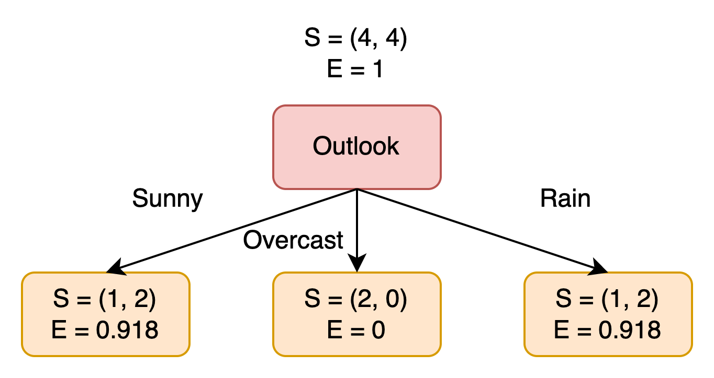
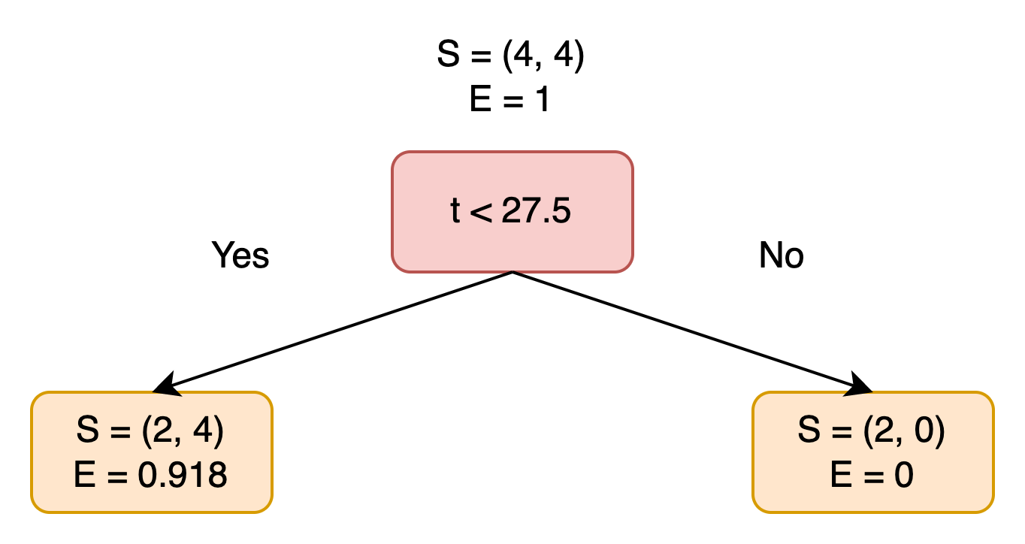
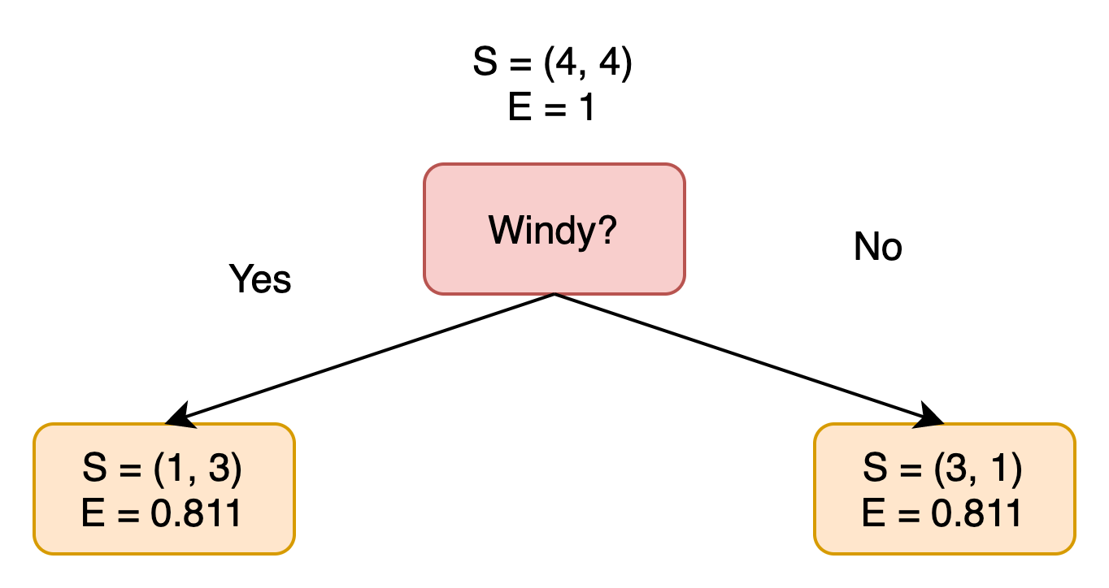



Example: first iteration
Best splits were either Outlook or t=27.5°C
We split on Outlook
We must then apply algorithm recursively to Sunny and Rain branches
$IG\left(outlook\right)≈$ 0.3113
$IG\left(t=27.5\right)≈$ 0.3113
$IG\left(windy?\right)≈$ 0.1887

Slide 39



Example: Sunny branch, split at t=28°C
Split at t=28°C classifies the branch
If all rows belong to the same class, make the current node as a leaf node with the class as its label
Outlook | Temperature | Windy | Well-attended
sunny | 29 | No | Yes
sunny | 27 | Yes | No
sunny | 22 | No | No
$H\left(t<28\right)$= - $\left(\frac{0}{0}\log_{2}\frac{0}{0}\right)$-$\left(\frac{2}{2}\log_{2}\frac{2}{2}\right)$ $≈0$
$H\left(t>28\right)$= - $\left(\frac{1}{1}\log_{2}\frac{1}{1}\right)$-$\left(\frac{0}{0}\log_{2}\frac{0}{0}\right)$ $≈0$
H(S_{sunny})=-$\left(\frac{1}{3}\log_{2}\frac{1}{3}\right)$- $\left(\frac{2}{3}\log_{2}\frac{2}{3}\right)≈0.9183$
$$IG\left(\text{S}\text{sunny},t=28\right)=0.9183$$

Slide 40

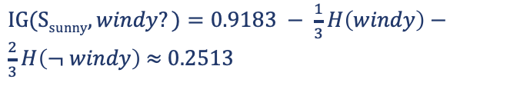

Example: Sunny branch, split at windy
Outlook | Temperature | Windy | Well-attended
sunny | 29 | No | Yes
sunny | 27 | Yes | No
sunny | 22 | No | No
$H\left(windy\right)$=-$\left(\frac{0}{0}\log_{2}\frac{0}{0}\right)$- $\left(\frac{1}{1}\log_{2}\frac{1}{1}\right)$ $≈0$
$H\left(¬windy\right)$=-$\left(\frac{1}{2}\log_{2}\frac{1}{2}\right)$- $\left(\frac{1}{2}\log_{2}\frac{1}{2}\right)$ $=1$
$IG(\text{S}\text{sunny},windy?\text{)}=0.9183 − \frac{1}{3}H\left(windy\right)−\frac{2}{3}H\left(¬ windy\right)$ $≈$ 0.2513
H(S_{sunny})=-$\left(\frac{1}{3}\log_{2}\frac{1}{3}\right)$- $\left(\frac{2}{3}\log_{2}\frac{2}{3}\right)$ $≈0.9183$

Slide 41



Example: Rainy branch, split at windy
Split along Windy classifies the branch
Make the current node as a leaf node with the class as its label
Outlook | Temperature | Windy | Well-attended
rain | 21 | Yes | No
rain | 20 | No | Yes
rain | 18 | Yes | No
$H\left(windy\right)$=-$\left(\frac{0}{2}\log_{2}\frac{0}{3}\right)$- $\left(\frac{2}{2}\log_{2}\frac{2}{2}\right)$ $≈0$
$H\left(¬windy\right)$=-$\left(\frac{1}{1}\log_{2}\frac{1}{1}\right)$- $\left(\frac{0}{1}\log_{2}\frac{0}{1}\right)$ $≈0$
$$IG\left(\text{S}\text{rain},windy?\right)≈0.9183$$
$$H\left(Srain\right)=−\left(\frac{1}{3}\log_{2}\frac{1}{3}\right)\text{− }\left(\frac{2}{3}\log_{2}\frac{2}{3}\right) ≈0.9183$$

Slide 42
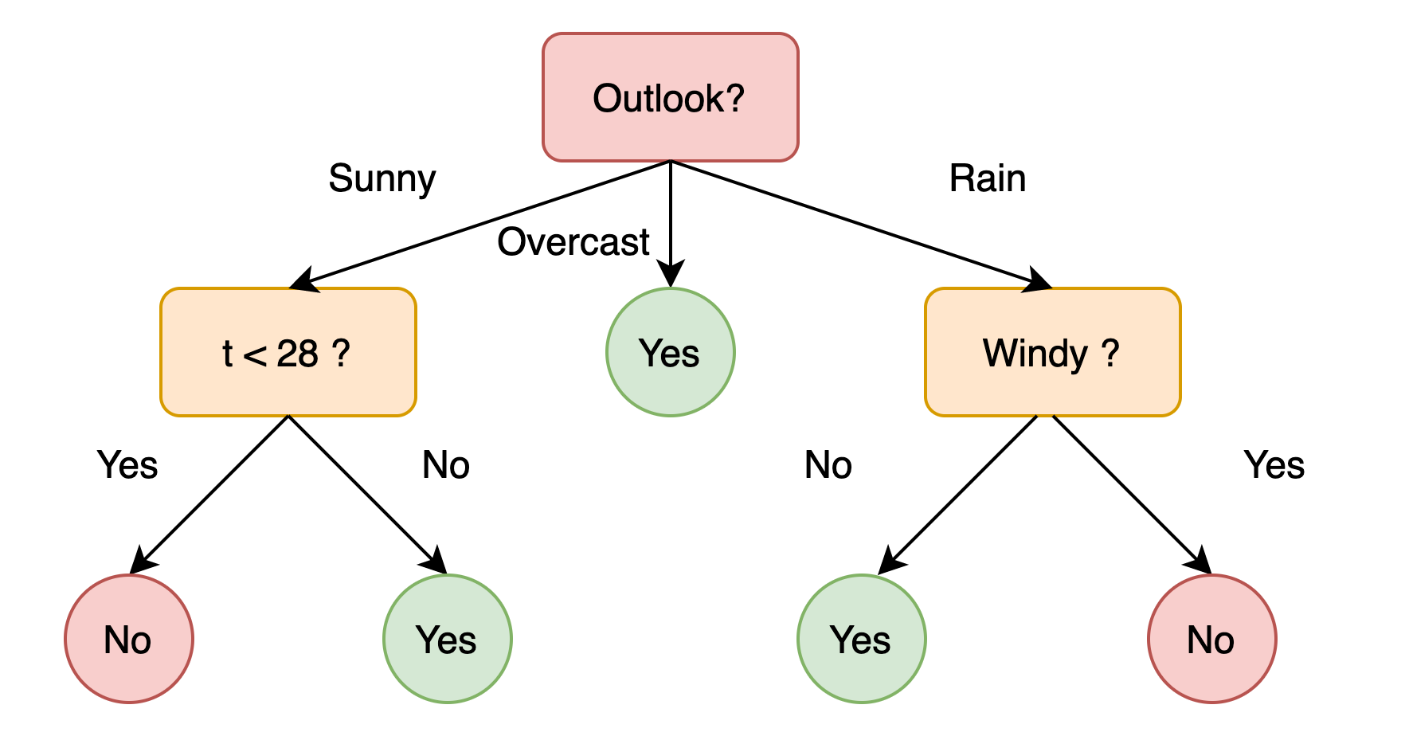
Example: the final tree

Slide 43
Example: the final tree
Test data
Outlook | Temperature | Windy | Well-attended
sunny | 15 | No | ?

Slide 44
Outline
Classification problem
Geometrical Interpretation
Attribute selection
ID3 algorithm
Avoiding overfitting

Slide 45
Overfitting
Overfitting happens when a learned decision process matches too closely to its training data
Thus it fails to generalise (classification performance drops on test sets)
It can occur when too few examples are associated with leaf nodes or where there is noise in the data
Sampling (choice of training examples) can alter perception of problem
Selection bias
Rare events
General solution: more data is not always possible

Slide 46
Reduced-error pruning
Labelled data are split into three sets:
Training set
Validation set is used for model selection (e.g. pruning the tree)
Test set is used to estimate how accurately the learnt model will work in the future
Goal: learn a tree that classifies pruning set well, though not trained on it
First build tree with ID3 on training set, then greedily prune nodes to improve classification of pruning set
Training
Color
red
blue
1 positive
0 negative
0 positive
2 negative
Validation
Color
red
blue
By predicting the negative class, we make 2 errors instead of 4
1 positive
3 negative
1 positive
1 negative
https://www.cc.gatech.edu/~bboots3/CS4641-Fall2018/Lecture2/02_DecisionTrees.pdf

Slide 47
Take-Home Messages
Information is measurable and can be quantified by entropy
Decision tree classifies items by a series of questions at non-leaf nodes until a leaf is reached, which gives the classification of the item
Tree is learnt from a training set
Information gain measures the change in entropy as the result of dividing the set into subsets according to an attribute
ID3 algorithm selects the attribute with the greatest information gain to subdivide the training set, and then the algorithm is applied recursively to the subsets
Overfitting is when a learned decision process matches too closely to its training data, and thus it fails to generalise
Validation set is used to select models (e.g. created by pruning the tree) and address overfitting

Slide 48
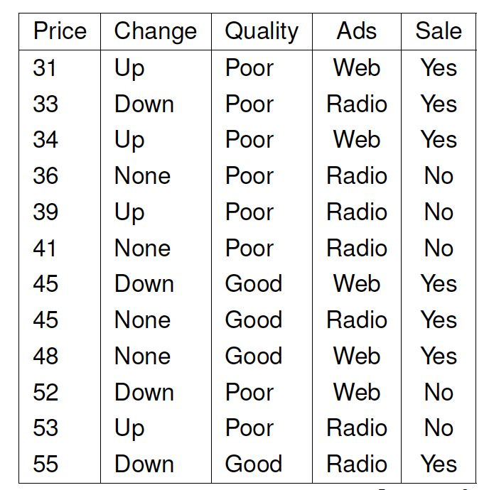
Past Example Question
Using the training data in the table below, execute the ID3 algorithm to build a decision tree classifier to shed light on the relationship between sales (represented by the variable Sale) and the attributes Price, Change (of price), Quality and Ads. Show all of your working and represent the final solution by drawing the decision tree.
[12 marks — advanced]

Slide 49
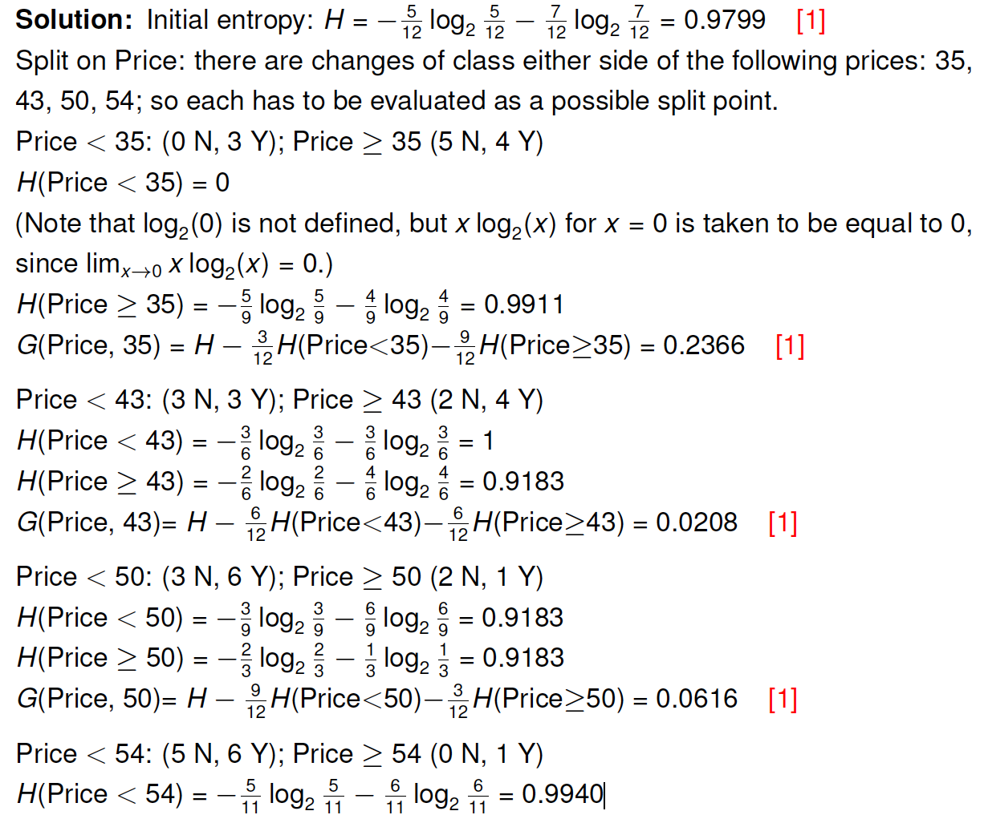
Past Example Question

Slide 50
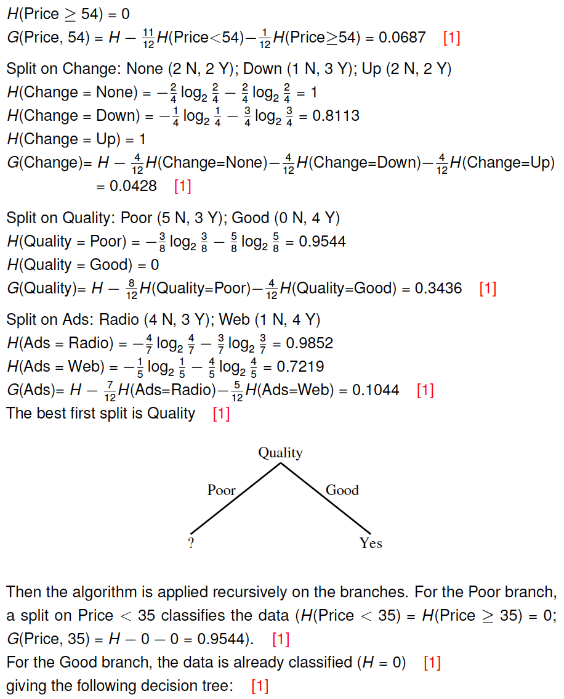
Past Example Question

Slide 51
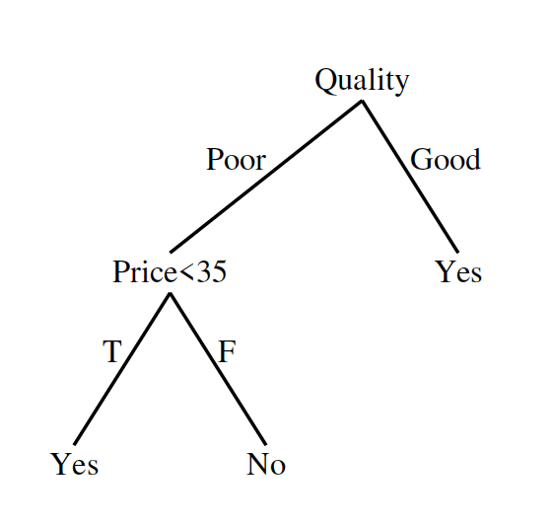
Past Example Question

